Slide 1

JJB BOT

Slide 2
Project Introduction - Statement
Personal Assistant Bot:
Most of the user experience applications are separate and are not integrated on one platform. This project aims to combine necessary and essential needs of the user into a single bot. Using the perfect mix of Natural Language Processing and multiple partner integrations, the bot will function as a personal assistant, combining more than 6 essential applications such as zomato,uber,musicmatch and more.
We also plan to take it a step further by adding home automation and security to make a more complete application.

Slide 3
SMART
HOME AUTOMATION
DRIVEN CONVERSATION
HOME SECURITY
JJB’s FEATURES
SPEECH TO TEXT
COURIER TRACKING
MULTILINGUAL
ZOMATO SEARCH

Slide 4
JJB
Hardware Requirements
RPI2
Relay Board
Software Requirements
Bot Farmework
Sensors
Devices
LUIS for NLP
Visual Studio
Azure SQL table

Slide 5
Literature Review
LUIS – Language Understanding Intelligent System which uses the N grams technique for tokenisation and intent identification.
Aftership – Combine Courier tracking applications.
Zomato – Restaurant booking and ordering systems.
Directline – To enhance the bot with a distinct UI.
FB_Developers – To release the bot on messenger
Google Developers – to add google search for non intents.

Slide 6
DESIGN FLOW DIAGRAM

Slide 7
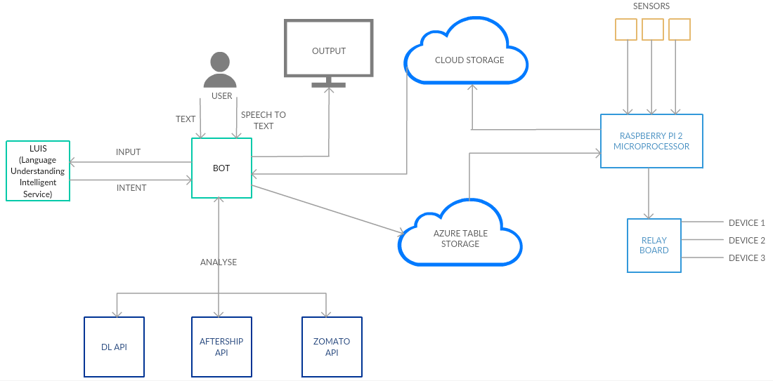

Slide 8
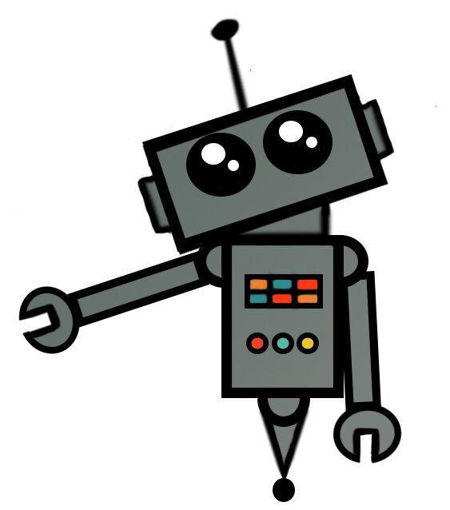
ENGINEERING PROCESS
LIO

Slide 9
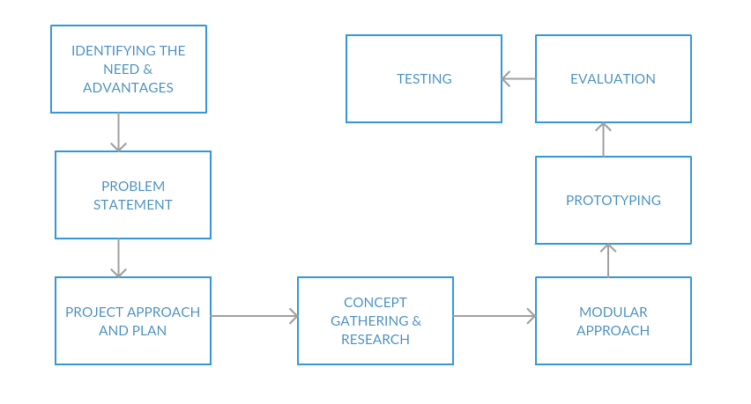

Slide 10
MODEL INTERACTION DIAGRAM

Slide 11
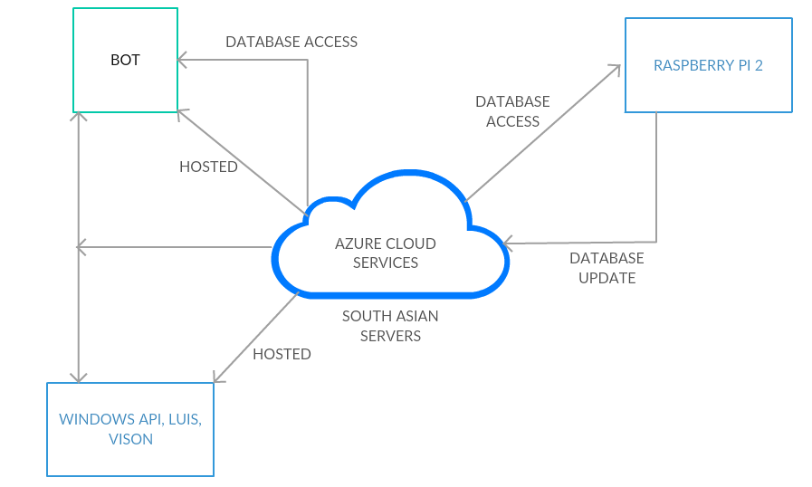

Slide 12
OPERATIONAL FLOWCHART

Slide 13
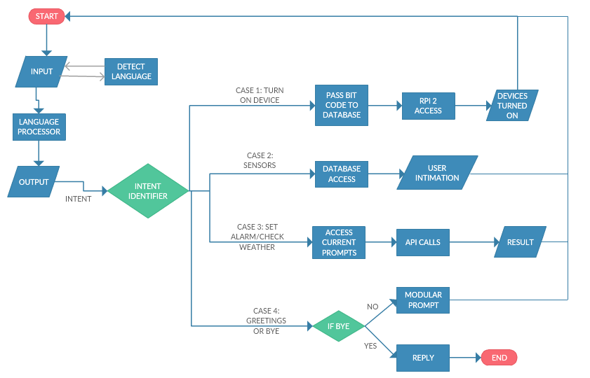

Slide 14
Our Future Scope
Product App
Uber SDK
Musixmatch API
Internship Accomplishments:
Denver Broncos bot
Same principles but released on the official NFL page
For JiffyBot which is now Sapien.

Slide 15
Results and Discussions:

Slide 16
THANK YOU!!!

